Slide 1
CS565: Intelligent Systems and Interfaces
Semester: Jan – May 2016
Ashish Anand
IIT Guwahati

Slide 2
What is this course?
Some stuffs on NLP focused on very specific aspects of NLP and their interface with ML in general, probabilistic modeling and neural nets in particular.
Will become clearer as we progress

Slide 3
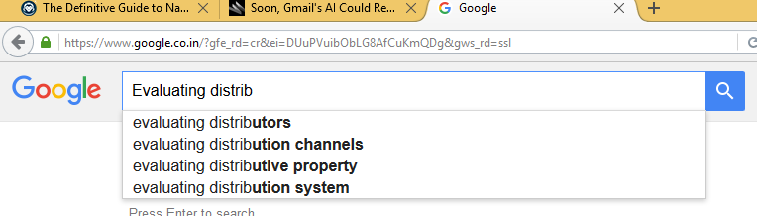
Do we see NLP in our daily life?

Slide 4
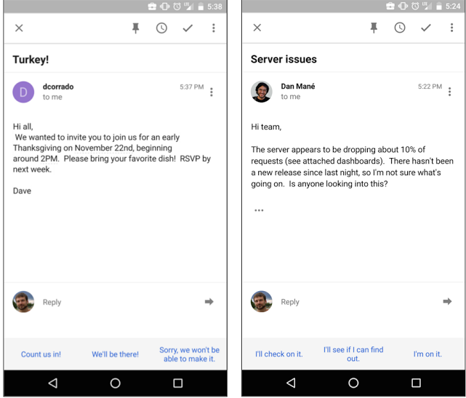
Do we see NLP in our daily life?
Source: http://googleresearch.blogspot.in/2015/11/computer-respond-to-this-email.html

Slide 5
Some Applications
Machine Translation
Automatic Summarization
Question-Answering System
Paraphrase detection
Sentiment Analysis
Text Classification
Conversational Agents
Many many more …..

Slide 6
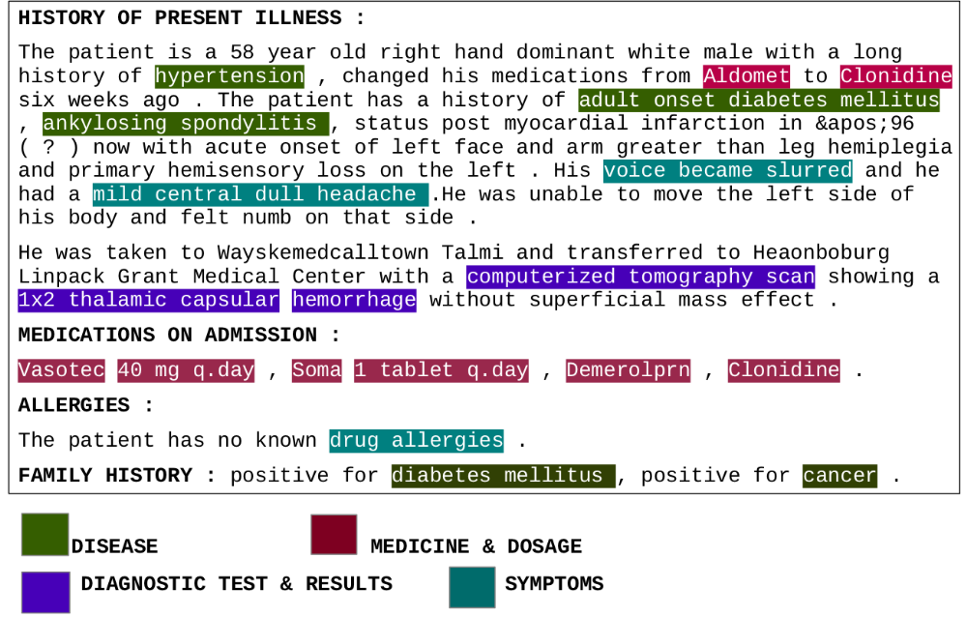
My motivation to study this course

Slide 7
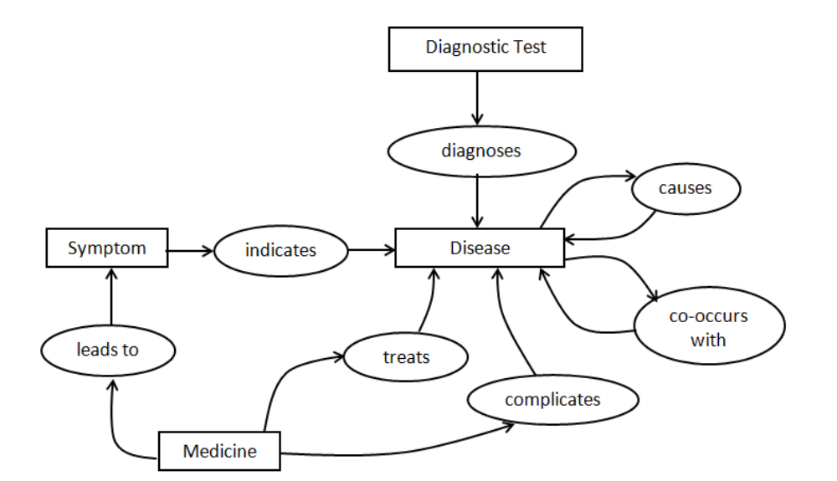
My motivation to study this course

Slide 8
Administrative Stuff

Slide 9
Administrative Stuff
Class Schedule
  Tue, Wed, Fri: E1 Slot
  Keep your Thursday E1 slot Free
Marks Distribution
  Assignments [1st will be posted next week]
  Project + Term Paper
  Exams [30% max]

Slide 10
Resources: Books
No Text Book
Reference Books
  Speech and Language Processing: Jurafsky and Martin
  Foundations of Statistical Natural Language Processing: Manning and Schutze
  Neural Networks and Learning Machines: Haykin

Slide 11
Resources: Online courses
http://cs224d.stanford.edu/syllabus.html [Deep Learning for NLP]
http://web.stanford.edu/class/cs224u/ [Natural language Understanding]
http://www.cs.columbia.edu/~mcollins/notes-spring2013.html
http://www.cs.columbia.edu/~cs4705/
http://www.cse.iitd.ac.in/~mausam/courses/csl772/autumn2014/

Slide 12
Resources: Online relevant materials
NLTK basic : http://www.nltk.org/book/
Python Numpy Tutorial : http://cs231n.github.io/python-numpy-tutorial/
More will be added due progress of the course.
Next week, course website/moodle/Piazza will be online.

